Slide 1
Business Process Engineering
Automation / Process Implementation
Lecture: 13

Slide 2
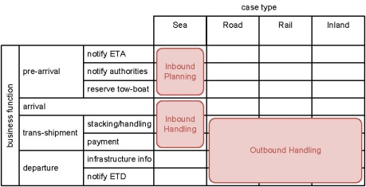
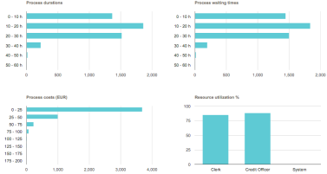

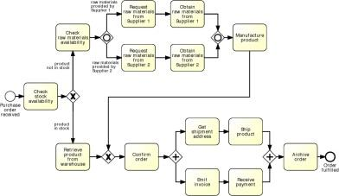
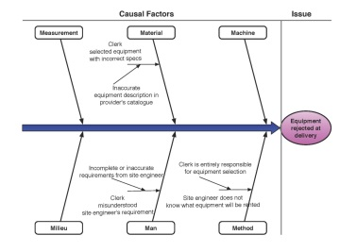
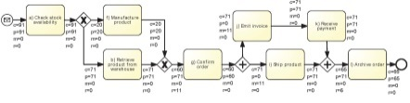
Where are we?
Notes:
Inspired by this message, one year ago we decided to survey the plethora of approaches, methods and techniques available in BPM and write this book (which builds upon) distil a comprehensive, yet succinct BPM methodology, which is the focus of this book “Fundamentals of BPM”. A methodology that would embrace the whole BPM lifecycle (without skipping any phase – in fact there are many valueable books that only focus on certain phases of the lifecycle), starting from the very beginning: process identification, through to process monitoring and controlling. Trying to strike a good balance between IT and management aspects, and would identify clear deliverables for each step of the lifecycle, by providing concrete, hands-on techniques to achieve these. For example, how I do I build a process architecture, how do I go about modeling a business process, how many discovery methods there exists, now that I have my model, what can I do with that etc.
No change management, process implementation only focuses to process automation.

Slide 3



From “conceptual” to executable models
Executable process models
are made by IT specialists
provide input to a process enactment system - BPMS
must be machine readable
must be unambiguous and should not contain any uncertainties
contain further details that are only relevant to implementation
Conceptual “to-be” process models
are made by domain experts
provide a basis for communication amongst relevant stakeholders
must be understandable
must be intuitive and may leave room for interpretation
contain purely a relevant set of process information
“to-be executed” process model
Notes:
Conceptual vs to-be-executed and executable
Add “to-be-executed model” as a bridge between the conceptual and executable process model

Slide 4
Bridging the gap: A five-step method
Identify the automation boundaries
Review manual tasks
Complete the process model
Adjust task granularity
Specify execution properties
Adapted from teaching material of Remco Dijkman, TU/e.
Notes:
Let’s see how we can achieve that. We propose a five-step method whereby we incrementally transform the conceptual process model in order to obtain an executable counterpart of this. First, we [read steps]. At the end of step 4 we obtain the “to-be-executed” model, which in final step gets finally transformed into the fully executable process model, by specifying execution properties.
This method is inspired from teaching material of Remco Dijkman.
Outline: we will cover the first four steps, until we obtain the to-be-executed pm in Part I of this tutorial. After the break, in Part II, we will cover the “last mile”.

Slide 5
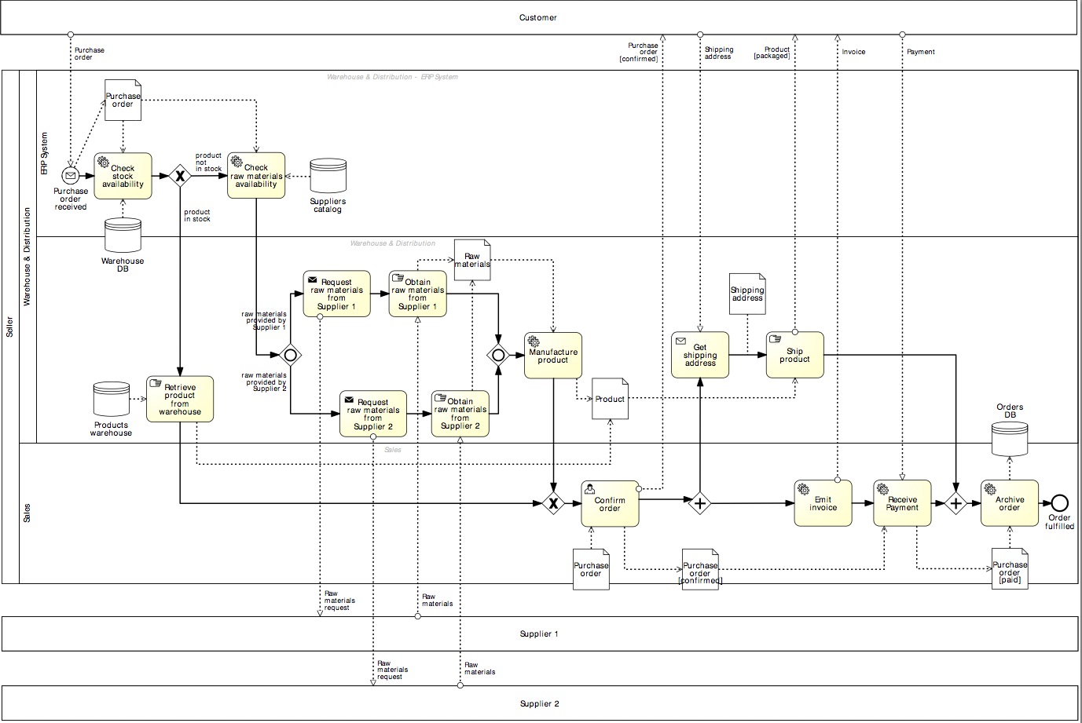
Our running example
Customer
Seller
Supplier 1
Supplier 2

Slide 6
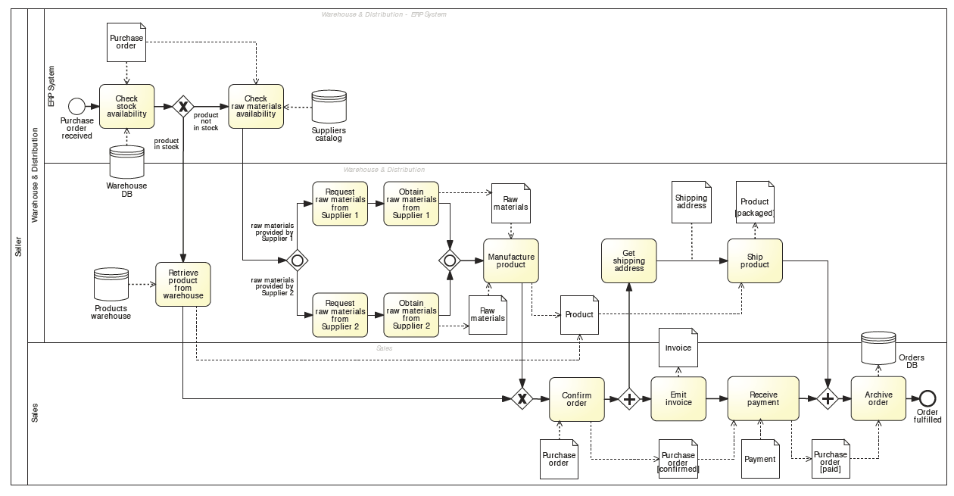
Our running example

Slide 7



1. Identify the automation boundaries
Principle: not all processes can be automated.
-> Start by identifying each task’s type:
1
2
3
Automated tasks
User tasks
Manual tasks
Notes:
We have to be honest about that. Not all processes can be automated. So we need to start by…
We can distinguish between automated tasks, i.e. those tasks that can executed by an external application or internally to the BPMS, for example checking the stock availability through an ERP system or retrieving a document from a DMS, user tasks, those tasks where process participants need to provide input to the process, typically via the use of web forms, and finally manual tasks, those which are entirely manual, such as retrieving a product from the warehouse

Slide 8
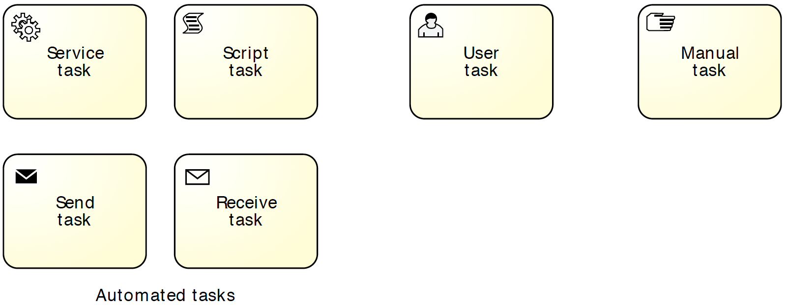
In BPMN: specify task markers
Automated tasks
User task
Manual task
Notes:
Identify automated, manual and user tasks:
Manual tasks are marked with a hand icon
User tasks are marked with a user icon (scheduled in worklist)
Automated tasks are subtyped in BPMN:
script (script marker), if the task executes some code (the script) internally to the BPMS. This task can be used when the functionality is simple and does not require access to an external application
service (wheels marker), if the task is executed by an external application, which exposes its functionality via a service interface
send (filled envelope marker), if the task sends a message to an external service
receive (empty envelope marker), if the task waits for a message from an external service

Slide 9
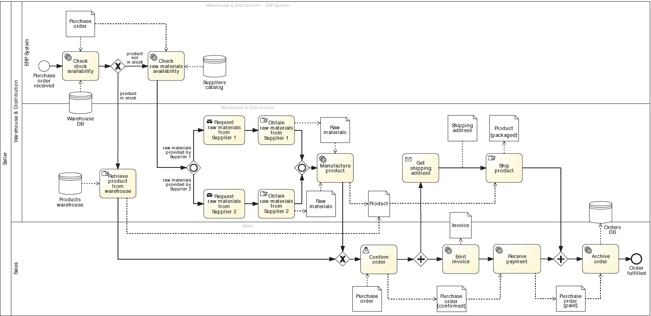
In our example…
automated
user
manual

Slide 10



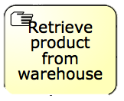
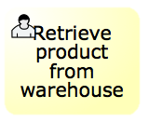

2. Review manual tasks
Principle: if it can’t be seen by the BPMS, it doesn’t exist.
-> Find ways to support manual tasks via IT:
via user task
via automated task
-> Isolate them and automate the rest
Notes:
Once we have identified each task’s type, and so the automation boundaries, we can review each manual task to see whether we can automate them or we have to isolate them. Here the principle is: …
Where the nice looking woman gets a notification on her mobile device to go and pick up the box from the shelf, and once she is done she scans the barcode of the product so that an automatic notification is sent back to the BPMS, which now knows it can move on

Slide 11
3. Complete the process model
Principle 1: Exceptions are the rule.
Consider incomplete paths
Rules of thumb
If we send something to another party, what happens if they do not respond? What happens if the response comes late? What happens if they do not respond the way we expect?
For each task: Can it go wrong and what happens if it goes wrong?
For each external party: Have we captured all messages or queries they might send us? (use CRUD)
Principle: no data = no decisions, no tasks handover.
Specify all (electronic) business objects
For each task, determine which business objects it creates, reads, updates, delete (CRUD)
For each decision, determine which objects it needs
Notes:
Process exceptions happen all the time and for as intelligent as a modern system can be, it can never foresee exceptions, which we need to implement, though it doesn’t need to be done all at once, it can be done in stages.
Tech-related exceptions: system crash, network outage, service unavailability, data mismatch
Bus-related: product discontinuation, order cancelation, out-of-stock items
BAs legitimately think it’s not relevant for communication purposes, they assume it’s common knowledge or they are not (fully) aware of it.
So first we need to Check for coverage of exceptions. Then we need to Specify all electronic data objects and split conditions

Slide 12
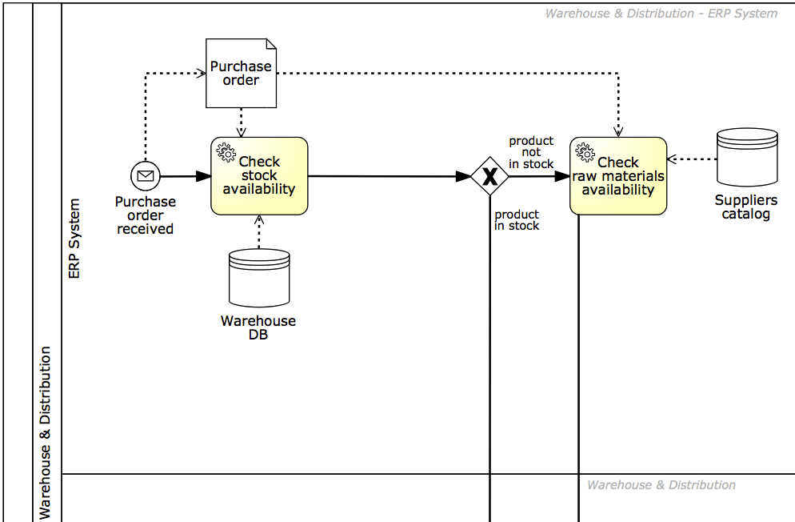
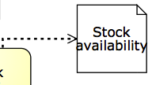
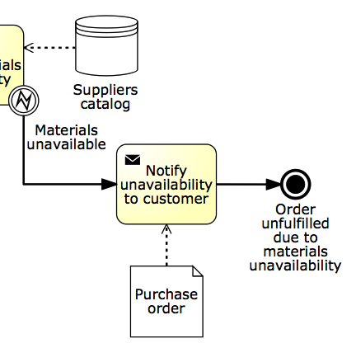
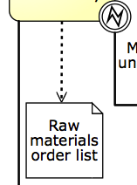
In our example…
Notes:
So first we need to Check for coverage of exceptions. Then we need to Specify all electronic data objects and split conditions

Slide 13
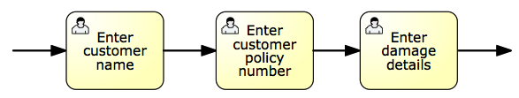


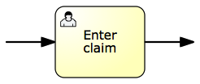
4. Adjust task granularity
Principle: BPMSs add value if they coordinate handovers of work between resources.
-> Aggregate any two consecutive tasks assigned to the same resource
-> Split tasks that are too coarse-grained
Notes:
There is not necessarily a 1-1 mapping between tasks in a conceptual process model and those in the executable counterpart.
Principle: a BPMS is intended to coordinate and manage handovers of work between multiple resources (human or non-human). Accordingly, two or more consecutive tasks are candidate for aggregation. If this was the case, the BPMS would not add any value as it would not manage any handover of work
Similarly, if an activity requires more than one resource to be executed, it is too coarse-grained and thus needs to be refined.
Aggregation: Enter customer name, enter customer policy number and enter damage details into Enter claim, if performed by the same claims handler
Refinement: Enter and approve money transfer, typically performed by two different participants with the same role, financial officer, in order to enforce a separation of duties

Slide 14
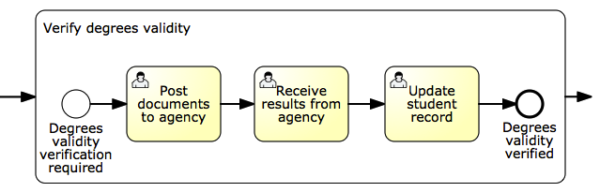
An exception to the rule
Notes:
Remember the student admission process?
Let’s take a look at this subprocess “Verify degrees validity”…
While these may be performed by the same admin clerk, we do want to report the completion of each task to the BPMS for the sake of monitoring the progress of the application, for example for auditability, also because there is typically some idle time between each task (e.g. after the documents have been posted and before receiving the results). It is also useful in this case to manage potential exceptions. For example, if the results aren’t received within a given timeframe, we can handle this delay with an exception handler attached to this task.

Slide 15
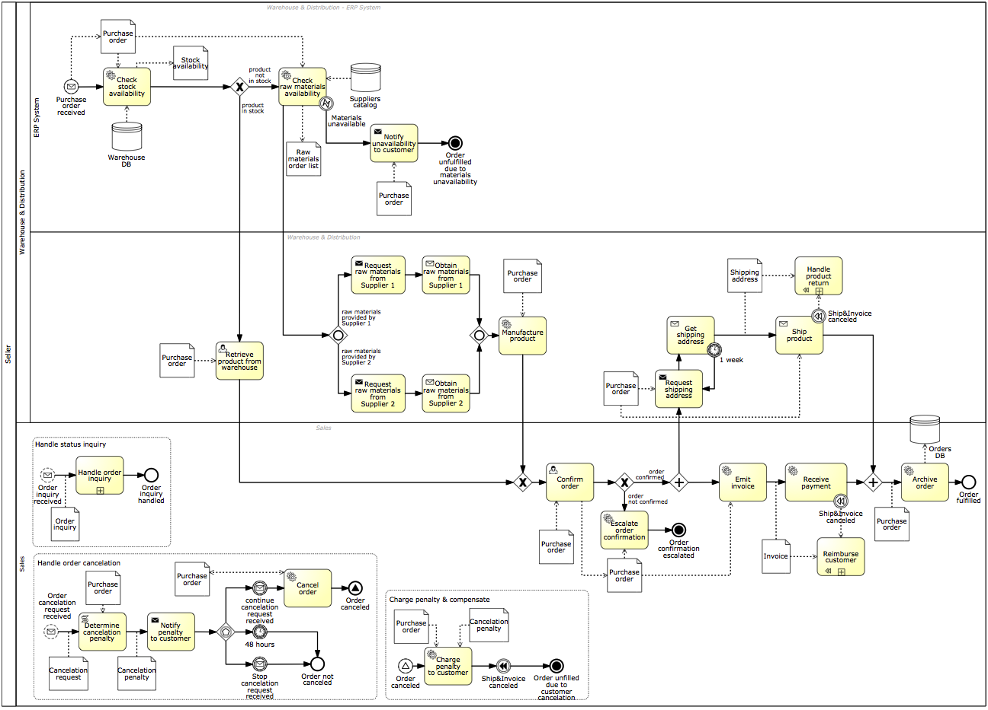
Our example…
After Step 4
Before Step 1

Slide 16
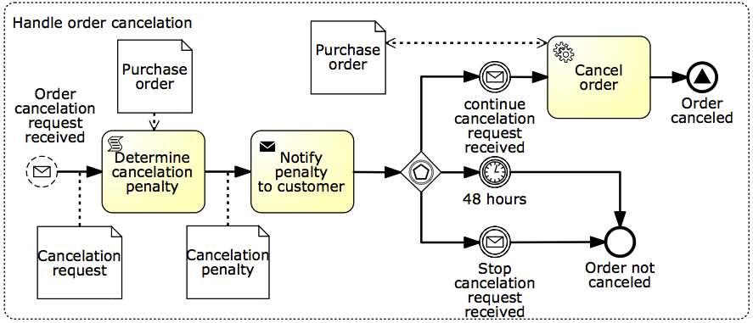
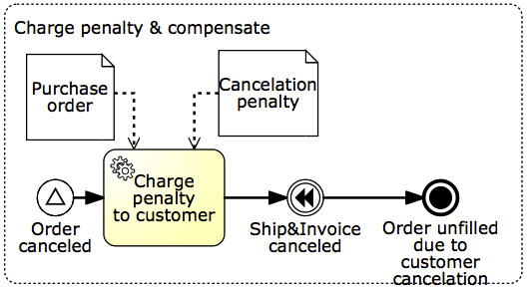
In our example…
Notes:
And there is virtually no limit to the number of exceptions we can capture in a model – it depends on how sophisticated is our system to be able to handle such exceptions.
In other words, the more exceptions we add, the more robust the solution will be.

Slide 17

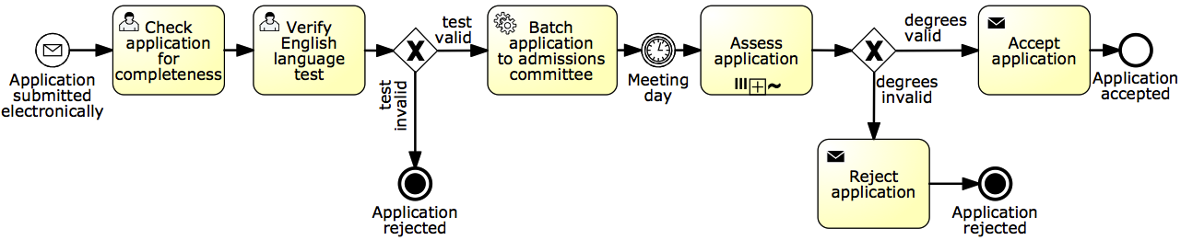
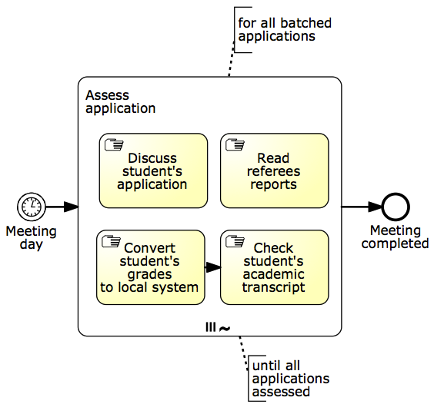
Alternative: isolate manual tasks
Notes:
Isolate manual tasks (use Example 9.1 – student admission process)

Slide 18
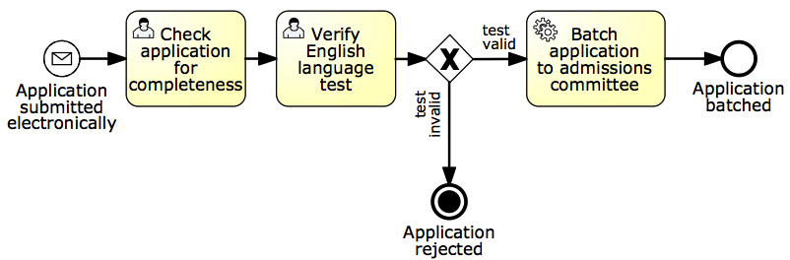
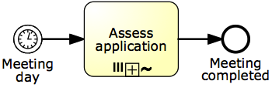
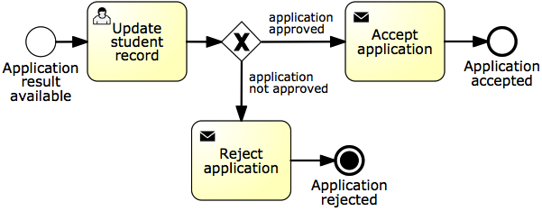
Alternative: isolate manual tasks
Segment 1
Segment 2
Segment 3
Notes:
Isolate manual tasks (use Example 9.1 – student admission process)

Slide 19















Quiz: let’s consider this process fragment
Prescription fulfillment process:
Once the prescription passes the insurance check, it is assigned to a technician who collects the drugs from the shelves and puts them in a bag with the prescription stapled to it.
After that, the bag is passed to the pharmacist who double-checks that the prescription has been filled correctly.
After this quality check, the pharmacist seals the bag and puts it in the pick-up area.
When a customer arrives to pick up their prescription, a technician retrieves the prescription and asks the customer for their payment.
Assume the pharmacy system automates this process. Identify the type of each task and link manual tasks to the system.
Notes:
Exercise 9.8
If therea are any manual tasks, find a way to hook them to the pharmacy system.
One way of modeling this fragment is by defining the following tasks: “Check insurance”, “Collect drugs from shelves”, “Check quality”, “Collect payment” (triggered by the arrival of the customer), and finally “Retrieve prescription bag”. Assume the pharmacy system automates the prescription fulfillment process. Identify the type of each task and if there are any manual tasks, specify how these can be linked to the pharmacy system.
Task “Check insurance” can be automated through a service that determines the amount of the co-payment based on the details of the prescription and on the customer’s insurance policy.
Tasks “Collect drugs from shelves” and “Check quality” are manual tasks. These tasks can be implemented as user tasks in the automated process. To do so, the pharmacy technician who collects the drugs, and the pharmacist who quality-checks the prescription and seals the bag, should have a convenient mechanism to signal the completion of these activities to the BPMS. This could be achieved by putting in place a system based on barcode scans to track prescriptions. For example, the technician would see a list of prescriptions to be filled from their worklist. They would then pick up one of the prescriptions and the system would associate the prescription to a new barcode which is printed on an adhesive label. The technician would then attach the label to a bag, collect the drugs and put them in a bag, and when done, they would scan the barcode from the label to record that the prescription has been fulfilled. This signals the completion of task “Collect drugs from shelves” to the pharmacy system. In turn, it generates a new work item of task “Check quality” in the pharmacist’s worklist. The pharmacist can then quality-check the prescription and scan the barcode again.
Task “Collect payment” is also a manual task. This task could be implemented as a service task whereby the pharmacy system would push the task of collecting the payment for a prescription to a Point-of-Sale (POS) system and expect the POS system to indicate that the payment has been collected. The pharmacy technician would interact with the POS system once the customer arrives, but this interaction is outside the scope of the pharmacy system. The pharmacy system merely pushes work to the POS system and waits for completion.
The description of the process implicitly refers to a manual task whereby the pharmacist seals the bag and puts it into the pick-up area. However, this “Seal bag” task is not included in the executable process model. Instead, this task is integrated into the “Check quality” task. In other words, at the end of the quality check, the pharmacist is expected to seal the bag if the prescription is ready and drop the bag in the pick-up area.
Task “Retrieve prescription bag” is also manual but there is no value in automating it in any way. So this task is left out of the executable process model, which completes once the payment has been made.

Slide 20
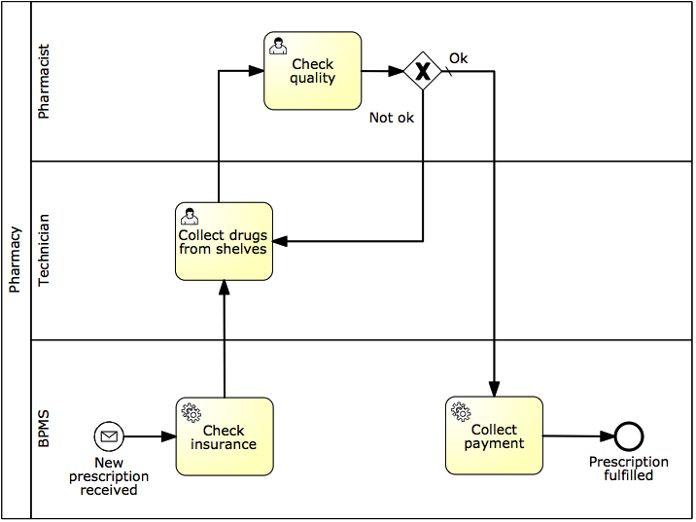

Possible solution
Notes:
TODO: Exercise 9.8 (prescription fulflliment process)

Slide 21
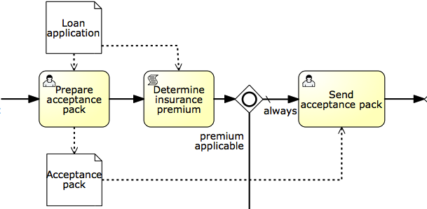
An exception to the rule
Candidate tasks for aggregation may not necessarily be consecutive due to a sub-optimal order of tasks in the conceptual model.
Notes:
Let’s consider this example in the context of a loan assessment process. A loan officer has to first…
Then an automatic check of the home insurance requirements is performed by the BPMS,

Slide 22
BPMN elements irrelevant for execution
Physical data objects
Messages bering physical data objects
Data stores (both physical and electronic)
Pools & lanes
Text annotations
Remove or neglect, depending on BPMS
Notes:
There are a few further elements besides manual tasks that are irrelevant for execution and that as such could potentially be removed or are actually not tolerated by the BPMS. These are:
Data stores are not interpreted since the BPMS assumes the existence of an external service that can communicate with the data store, e.g. an Inventory information service that can access the warehouse DB in our example. In general, databases are accessed via DB adapters, e.g. a MySQL Adapter. So the BPMS will interface with these services rather than with the data store directly. Still, at the conceptual level, it may be relevant to explicitly represent the data store.
Pools and lanes, you would be surprised, but are discarded by BPMSs. This is because they capture coarse-grained resource assignments, e.g. activity “Confirm order” is done within the sales department. When it comes to execution, we need to define resource assignments for each task and capturing this information via dedicated lanes (potentially one for each task) will just make the diagram too cluttered.
Some BPMSs tolerate the presence of these non-executable elements too. If this is the case, we suggest to leave these elements in. Especially pools, lanes, message flows bearing electronic objects, electronic data stores and annotations will guide us in the specification of some execution properties. For example, the Sales lane in the order fulfillment model tells us that the participant to be assigned task “Confirm order” has to be from the sales department. Other BPMS modeling tools do not support these elements, so it is not even possible to represent them in the diagram.

Slide 23


3. Complete the process model
Principle: exceptions are the rule.
-> Add exception handlers
Principle: no data = no decisions, no tasks handover.
-> Specify all electronic business objects
It happed for real!
Notes:
Process exceptions happen all the time and for as intelligent as a modern system can be, it can never foresee exceptions, which we need to implement, though it doesn’t need to be done all at once, it can be done in stages.
Tech-related exceptions: system crash, network outage, service unavailability, data mismatch
Bus-related: product discontinuation, order cancelation, out-of-stock items
BAs legitimately think it’s not relevant for communication purposes, they assume it’s common knowledge or they are not (fully) aware of it.
So first we need to Check for coverage of exceptions. Then we need to Specify all electronic data objects and split conditions

